Slide 1
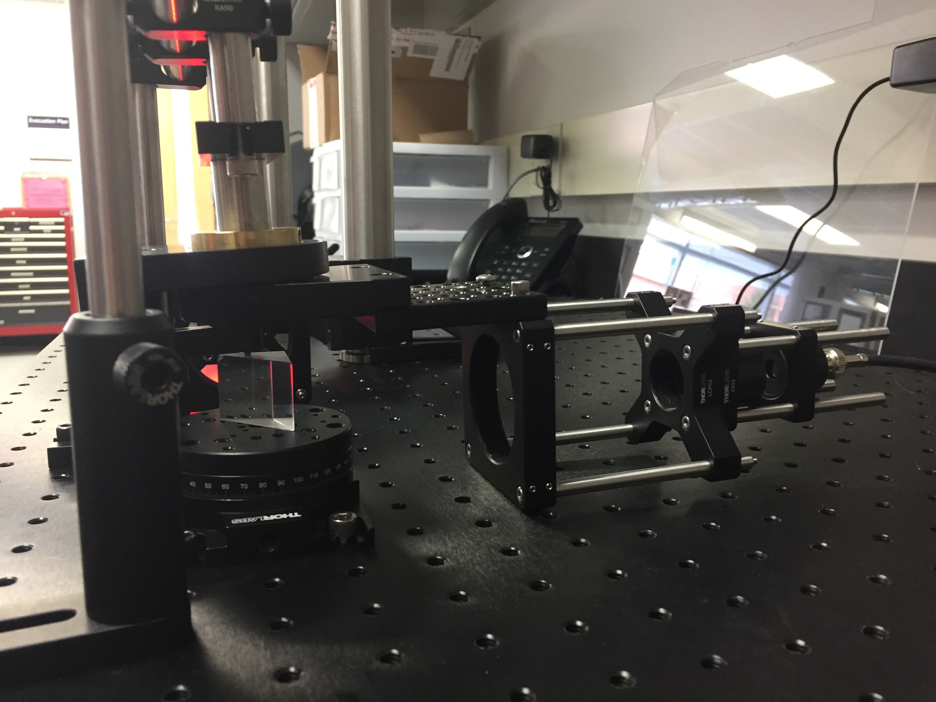
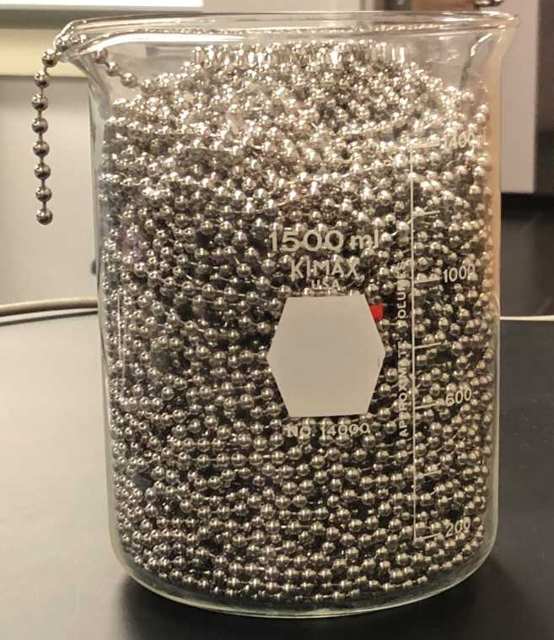
Introduction
Graded assignments included lab notebook checks, several short oral reports, a poster, a paper, and a final group oral report.
The first week of class was spent discussing use of lab notebooks, data plotting, and how to be an effective member of a team. Students also indicated their preferences for choice of experiment based on what skills they already have and what skills they would like to develop.
Students where assigned to one of five research groups, with one advanced student working with one or two introductory students. Each research group worked on one project for the entire semester. Since this was the first offering of the course, many of the
“[This class] has made me more confident with scientific research. I was not sure how to structure an experiment before taking this class. “
A new Advanced Physics Lab course was developed to give students experience will soft skills, such as leadership and mentoring, working in teams, scientific ethics, and communication skills along with the traditional experimental skills. The advanced lab course was offered in conjunction with a freshman level Introduction to Research Methods in Physics course. This combination of two different levels of students was done to populate a traditionally low-enrolled upper-division course, to provide senior students with leadership experience, and to provide freshmen an authentic research experience. The intro-level course has no physics prerequisite and counted as a general education science credit so it was open to students of all disciplines. Students were formed into teams of two to three students with a senior student as the team leader.
The introductory course focused on basic scientific research methods, keeping lab notebooks, working as a member of a team, scientific ethics, and scientific communication. The advanced lab course focused on team leadership, experimental design, and more advanced data analysis and scientific communication, along side the traditional experimental skills.
Experimental Design – Big and Little Questions
experiments started off in very embryonic states, which made it easy for students to expand the experiments. Experiments included saturation absorption spectroscopy of rubidium, characterization of plasma-created nanoparticles, stabilization of a HeNe laser, surface plasmon resonance in thin films, and exploration of a chain fountain.
“This class is very helpful for teaching group dynamics, most projects in other classes are not nearly as long. For freshman, its very good and should almost be required, for seniors, it is also good but noticeably less so”
“I did not like physics before I took this class. I was never very good at it and I was thinking it was going to be really hard. But now I love this class and I feel like I know what I am doing and how my skills relate to our experiment. “
Teamwork
Course Goals
Two lecture class periods were spent on teamwork (for the intro class) or leadership (for the advanced class). At the end of each week the group would come together to answer the questions “what is an example of something you did this week that shows good teamwork” and “what can you do next week to improve your ability to work as a team”.
The advanced students would spend the first few minutes of the weekly lecture section discussing successes or issues that came up in their group and discussed how to improve their group performance.
Course Goals for Introduction to Research Methods in Physics:
A student who has successfully completed this course will be able to:
1.Explain the purposes and goals of experiments.
2.Design an experiment to test a hypothesis
3.Analyze data and report relevant information
4.Communicate scientific information orally and in writing
5.Work effectively in a team
Course Goals for Advanced Physics Lab:
A student who has successfully completed this course will be able to:
1.Use typical experimental physics equipment
2.Design an experiment to test a hypothesis
3.Analyze data and report relevant information
4.Communicate scientific information verbally and in writing
5.Read research articles
6.Lead a team of researchers
“[This class] made me realize that working in a team can be beneficial if the team leader has an idea of the direction they want to go and if the teammates are motivated. “
Communication Skills
TEXT HERE
References
“[This class] made me realize how much of a collaborative effort real research can be, as well as how time-consuming it can be.”
[1] Stanley, J. T., & Lewandowski, H. J. (2016). Lab notebooks as scientific communication: Investigating development from undergraduate courses to graduate research. /Phys. Rev. Phys. Educ. Res./, /12/(2), 020129–11. http://doi.org/10.1103/PhysRevPhysEducRes.12.020129
[2] Stanley, J. T., Dounas-Frazer, D. R., Kiepura, L., & Lewandowski, H. J. (2016). Investigating student ownership of projects in an upper-division physics lab course (pp. 336–339). Presented at the 2016 Physics Education Research Conference, American Association of Physics Teachers. http://doi.org/10.1119/perc.2016.pr.079
[3] Atkins, L. J., Proceedings, I. S. A. C., 2013. (n.d.). Using scientists’ notebooks to foster authentic scientific practices. /Aip.Scitation.org/
[4] Wilcox, B. R., & Lewandowski, H. J. (2017). Improvement or selection? A longitudinal analysis of students’ views about experimental physics in their lab courses. /Phys. Rev. Phys. Educ. Res./, /13/(2), 023101. http://doi.org/10.1103/PhysRevPhysEducRes.13.023101
Stanley, J. T., & Lewandowski, H. J. (2018). Recommendations for the use of notebooks in upper-division physics lab courses. /American Journal of Physics/, /86/(1), 45–53. http://doi.org/10.1119/1.5001933
[5] Eblen-Zayas, M. (2015). Comparing Electronic and Traditional Lab Notebooks in the Advanced Lab (pp. 28–31). Presented at the 2015 Conference on Laboratory Instruction Beyond the First Year, American Association of Physics Teachers. http://doi.org/10.1119/bfy.2015.pr.007
Course Structure
Both courses had two 3-hour lab sessions that met together and a separate 1-hour lecture session for each course each week. This initial offering of the course had 6 students in the advanced course and 8 students in the introductory course. Although most of the students were physical science majors, two students were math majors and one student was an interior design student.

